Slide 1
Capstone Project
(Background and Objectives)
HR Analytics: To develop scientific method of understanding factors that lead to Attrition in an organization

Slide 2

Background
Client
A healthcare R&D organization
Background
The company 1470 employees . Over the last year , The HR team has collected and consolidated information through various sources ( like survey , appraisal report, salary structure etc. ) about each employee
The company wants to understand what parameters impact the attrition in the organization and how can they make the work place a more conducive environment

Slide 3
Background
Objective
To analyze attrition and correlate with other factors
To develop employee attrition model
To analyze employee sentiments

Slide 4
Background
4. Data
The data used for the same is the employee data as on 31st Dec ’2022
The data available is the following :
Employee Attrition
Employee Demographics
Employee Income
Employee Job details
Exit Interview Responses

Slide 5
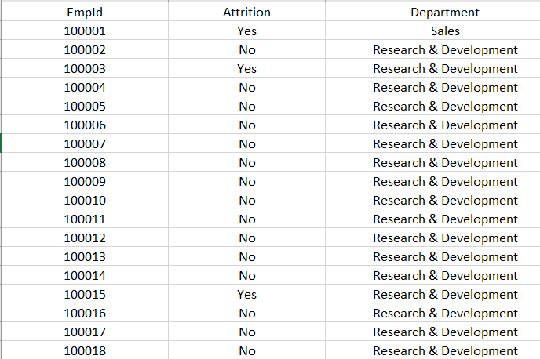
Data : Employee Attrition
Content
This data is mainly to understand whether the Employee has resigned or not anytime in the year 2022
Columns | Description | Type | Measurement | Possible values
EmpID | Employee ID | numeric | - | -
Attrition | whether he has resigned anytime in the year ‘19 | Factor | - | Yes, No
Department | Department | Factor | - | Sales , HR , R&D

Slide 6
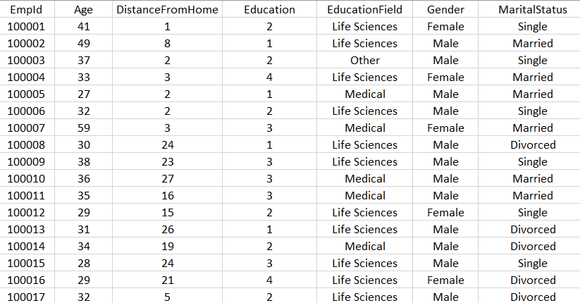
Data : Employee Demographics
Content
This data is mainly about the demographic factors of the employee
Columns | Description | Type | Measurement | Possible values
EmpID | Employee ID | numeric | - | -
Age | Age of the employee | numeric | - | -
DistanceFromHome | Distance from home in kms | numeric | - | -
Education | Score based on level of education | ordinal | 1 'Below College' 2 'College' 3 'Bachelor' 4 'Master' 5 'Doctor' | 1,2,3,4,5
Educationfield | Field of Education | factor | - | -
Gender | Gender | factor | - | Male, Female
MaritalStatus | Marital Status | factor | - | Single , Divorced , Married

Slide 7
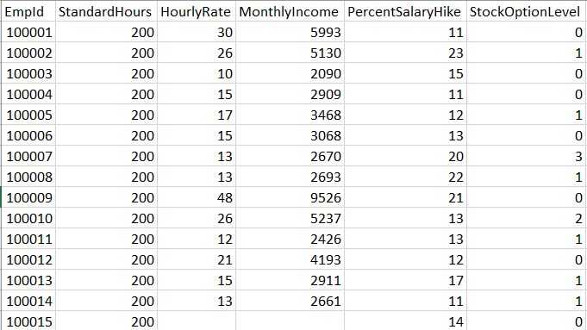
Data : Employee Income
Content
This data is mainly to understand his income components
Columns | Description | Type | Measurement | Possible values
EmpID | Employee ID | numeric | - | -
StandardHours | Minimum no of hours to be spent at work in a month | Numeric | Since all are full time employees , 200 is the std hours across | 200
HourlyRate | How much does the employee make per hour | integer | - | -
MonthlyIncome | Monthly Income | Numeric | - | -
PercentSalaryHike | Field of Education | Factor | - | -
StockOption Level | No of stocks as a part of compensation benefits | Factor | 0- none 1- <20 2-21-40 3->40 | 0,1,2,3,

Slide 8
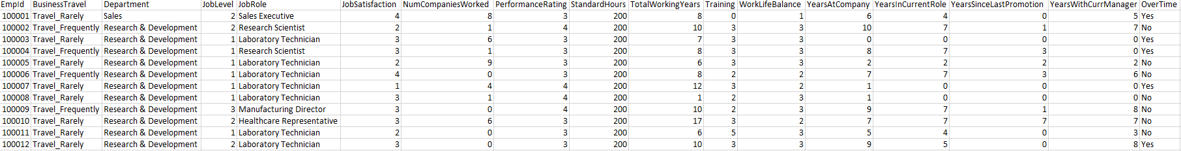
Data : Employee Job Details
Content
Content
This data is mainly to understand his job details .
Columns | Description | Type | Measurement | Possible values
EmpID | Employee ID | numeric | - | -
BusinesTravel | Does the employee need to travel for work : Never , Rarely or Frequently | factor | - | Non-Travel, Travel_Rarely, Travel_Frequently
JobLevel | Level of Job. | Ordinal | 1 =lowest ;5-highest | 1,2,3,4,5
JobRole | Job Role | Factor | - | -
Jobsatisfaction |  | Factor | 1=Low; 2=Medium; 3=High; 4=Very High | 1,2,3,4
NumCompaniesworked | No of Companies worked previously | integer | - | -
PerformanceRating |  | Factor | 1=Low; 2=Good ;3=Excellent; 4=Outstanding | 1,2,3,4
Overtime | If the person has worked over 250 hrs in the month, OT= Yes | Factor | - | Yes,No
TotalWorkingYears | Total years of Experience | integer | - | -
Trainings | No of Training programs attended in | integer | - | -
WorkLifeBalance | Rating based on a survey conducted for work life balance | Ordinal | 1=Bad; 2=Good; 3=Better; 4=Best | 1,2,3,4
YearsAtCompany | No of year spent in the current organzation | integer | - | -
YearsatCurrentRole | No of years in the current role | Integer | - | -
YearssinceLastPromotion | No of years since the last promotion | Integer | - | -
YearsWithCurrManager | No of years with current manager | Integer | - | -

Slide 9
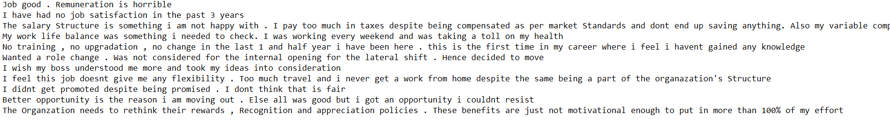
Data : Exit interview responses
Content
The response captured for the question “What is the main reason for your resignation ? You can be completely honest as this response is anonymous
Sample Size : 50
Description | Type
Consumer Responses | text

Slide 10




Next steps
Data management
Descriptive Statistics
& Data visualization
Predictive modelling
Text mining
Understanding the data better like checking attrition rate dept wise , is salary playing a role in attrition etc.
How can this data be presented better visually ?
Once again post Data visualization check if any variable needs to be feature coded
Understand the employee responses using various Text mining Techniques
Answer the objective:To understand the main reasons for quitting the organization
Compile all 4 data files based on Employee ID
Data cleaning , Handling missing values and completing Basic Data checks
Check if any variables needed to be feature coded i.e made into groups or want to be left as continuous variables e.g Age
Answer the objectives a) To understand factors to pre-empt which employees who are likely to leave in ’20 b) To identify the parameters that lead to early churn (within 18 months of joining)
Using different Predictive model techniques to find Significant variables
Ensure you follow all steps like Train and test data , checking for Multicollinearity
Check if any other ML technique fits better
* You can go through the Questions and Hint ppt to understand each section better / cross check if you have done all the steps mentioned

Slide 11
THANK YOU!

